Slide 1

KGiSL INSTITUTE OF TECHNOLOGY
COIMBATORE
Department of Computer Science & Engineering
Mini - Project Phase Review # 03
TAXI MANAGEMENT USING TKINTER FRAMEWORK
TEAM MEMBERS:
711720104061. Pavithra B
711720104064. Priyadharsini M
711720104071. Rositha A
711720104092. Sowmiya P
Under the guidance of :
Ms. Aruna T N

Slide 2

Agenda
Objective of the project work
Existing System
Proposed System
Expected Outcome
References
Timeline

Slide 3
OBJECTIVE OF THE PROJECT WORK
The system aims to streamline the operations, improve customer service, and enhance overall efficiency for both taxi drivers and passengers. Here are some specific objectives of a taxi management system using Tkinter:
User Registration and Authentication
Booking and Dispatching
Admin Dashboard
Payment Processing

Slide 4
EXISTING SYSTEM
Literature Survey
Existing System
Drawbacks / Pitfalls of the Existing system

Slide 5
Literature Survey
S.no | Title | Author | Published Year | Description
1 | Design and Application of Taxi Intelligent Integrated Service and Management Information System | Yueming Peng,Shanshan Liu, Xinglong Dai | 2018 | Providing a high-performance processing power, highly reliable data security, clear visual data and other advantages to assist the taxi management.

Slide 6
Literature Survey
S.no | Title | Author | Published Year | Description
2 | Research on the optimization of allocating resources of urban taxi based on decision analysis model | Weiyu Chen, Haochi Wu, Zhen Wang, Jialven Huang, ring Jiang, Jing Zhang, Lingxuan Zhu | 2016 | Includes optimum scheme by using Analytic Hierarchy Process Model and evaluate the extent of the impact of each scheme on solving the problem by using Decision Analysis Model

Slide 7
Literature Survey
S.no | Title | Author | Published Year | Description
3 | A Service Choice Model for Optimizing Taxi Service Delivery | Shih-Fen Cheng and Xin Qu | 2009 | Proposeto leverage on infrastructure and build a service choice model that helps individual drivers in deciding whether to serve a specific taxi stand or not

Slide 8
EXISTING SYSTEM
EXISTING FEATURES OF THE PROPOSED SYSTEM
User Interface: This is the front-end component that allows users to interact with the system
Booking Management: The booking management component handles the processing of customer requests
Administrative Dashboard: Provides a back-end interface for system
administrators to manage and monitor the system
Payment Integration: This component facilitates the payment process by integrating with payment gateways
or third-party payment services Database.
Database :The database stores and manages information about the system's users, drivers, and type of vehicles

Slide 9
EXISTING SYSTEM
EXISTING APPLICATIONS:
BOLT : Europe and Africa
DIDI : China

Slide 10
Pitfalls of the Existing system
Complex UI : User interface shall be difficult to understand and
implement.
High Pricing : pricing can be relatively high in some
applications
Customer support : difficulty in getting timely responses or effective
solutions
Learning curve : set of features and capabilities challenging for
new users to learn and navigate software effectively

Slide 11
PROPOSED SYSTEM
Proposed method
Advantages over existing method
Architectural Diagram followed by Modules split up

Slide 12
PROPOSED METHOD
The taxi management system is implemented using python tkinter framework.
WHY TKINTER?
Ridiculously fast
Reassuringly secure
Exceedingly scalable
Incredibly versatile
Easy to Integrate with Python Libraries/Functions

Slide 13
Advantages over existing method
Provides a simple and attractive UI design.
Comparatively low Pricing.
Provides high customer support.
Easy learning curve
Customer safety features

Slide 14
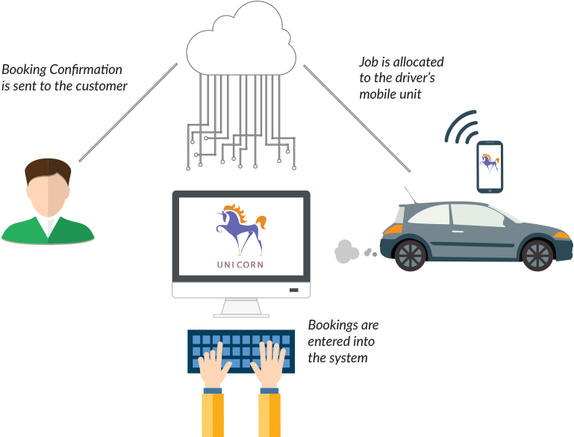
Architectural Diagram

Slide 15
Modules split up
Module 1 : Designing login and sign up page.
Module 2 : Creating the main booking page.
Module 3 :Generating receipt and exit.

Slide 16
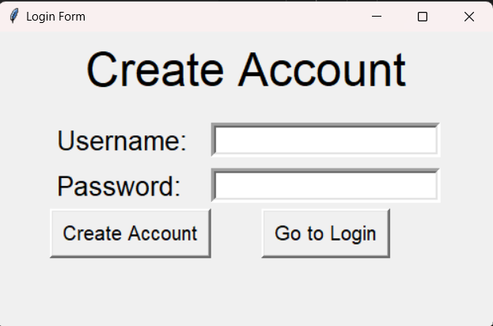
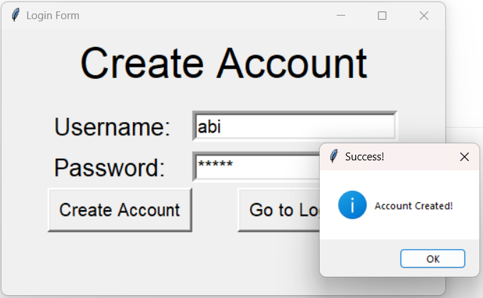
Module 1 – Designing the login or signup page

Slide 17
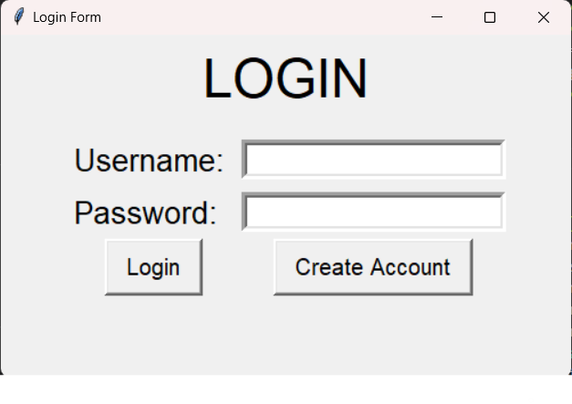
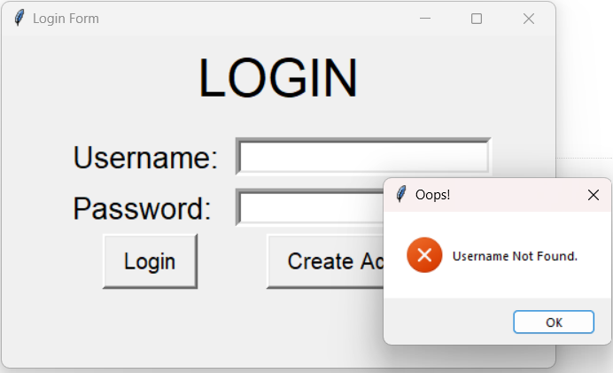

Slide 18
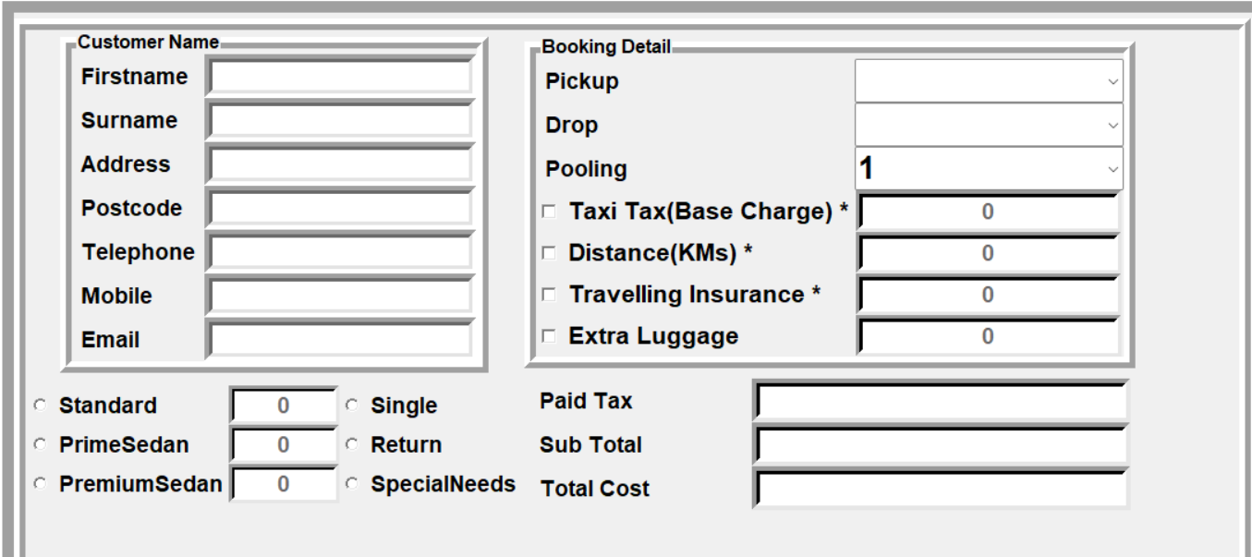
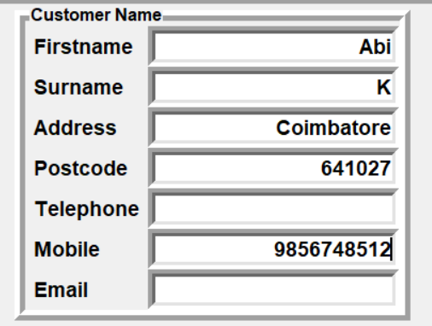
Module 2 – Creating the main booking page

Slide 19
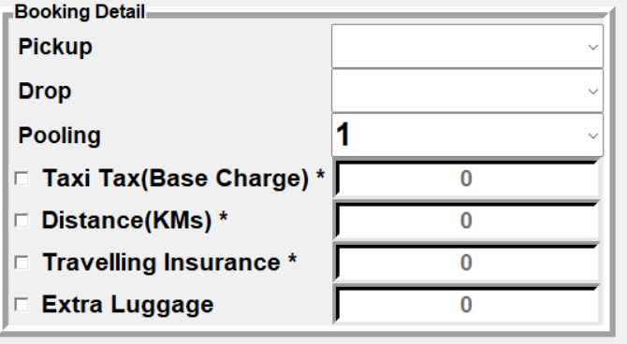
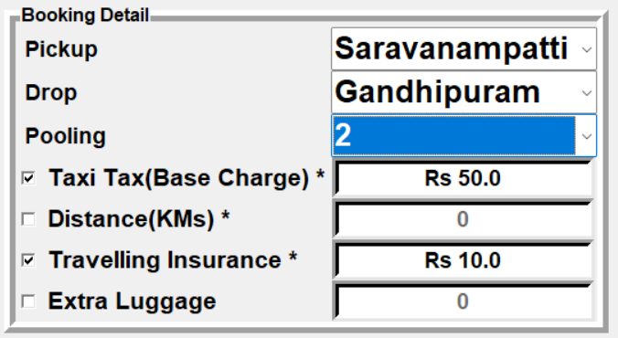

Slide 20
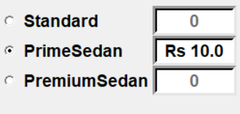
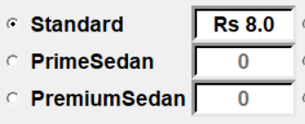
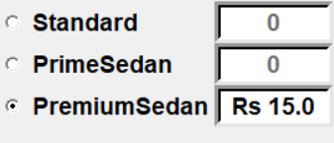
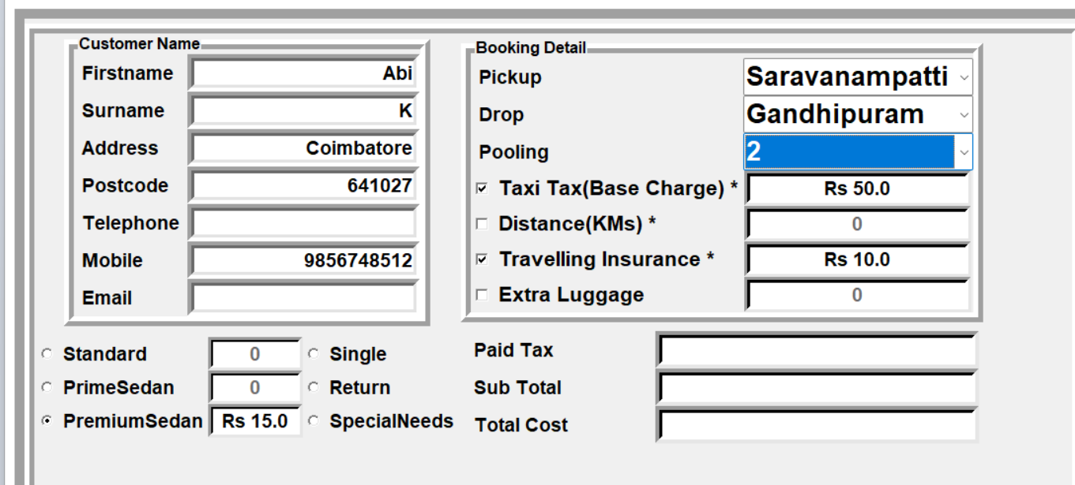

Slide 21
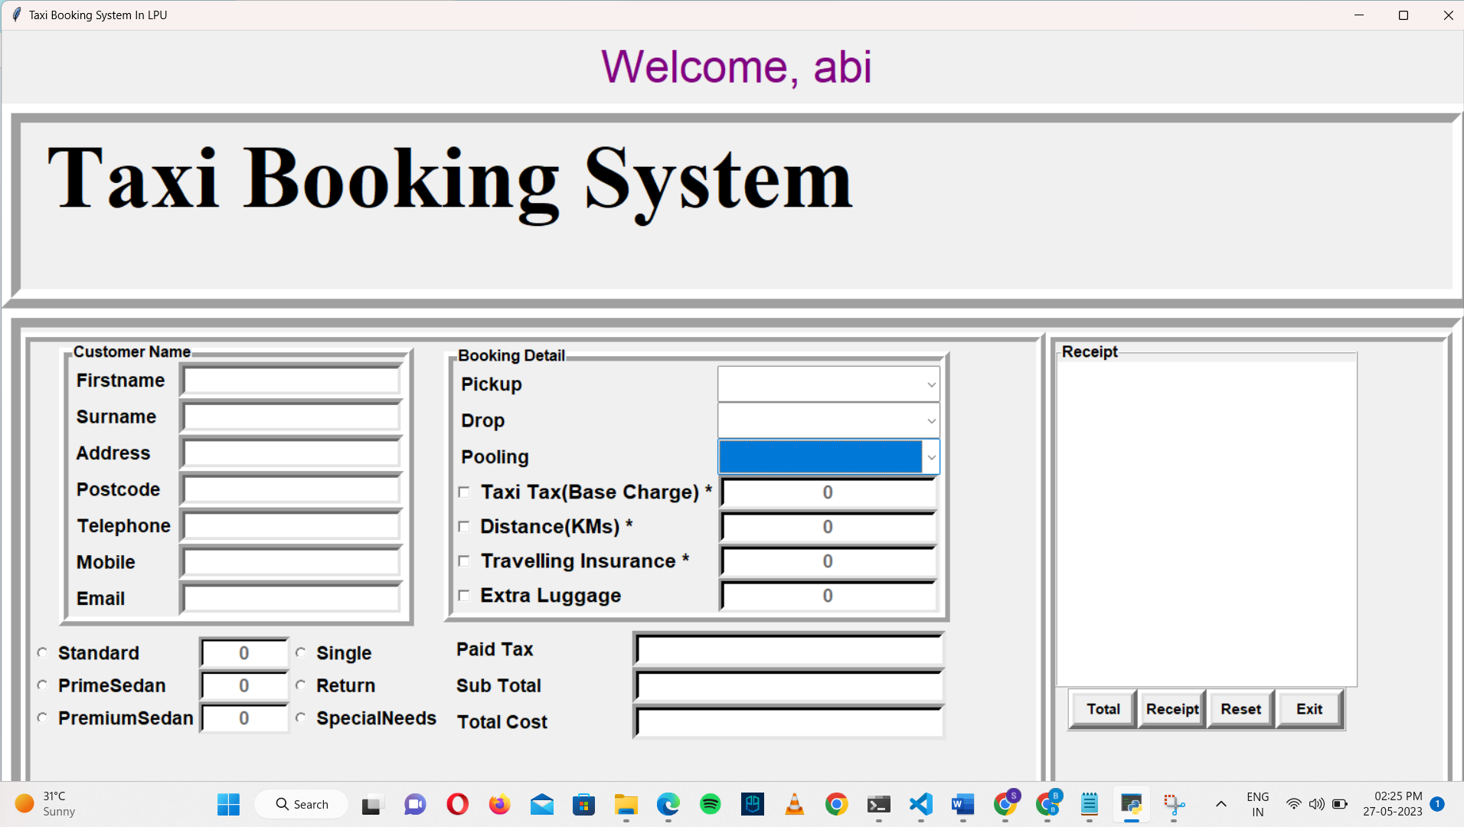
Module 3- Generating receipt and exit.

Slide 22
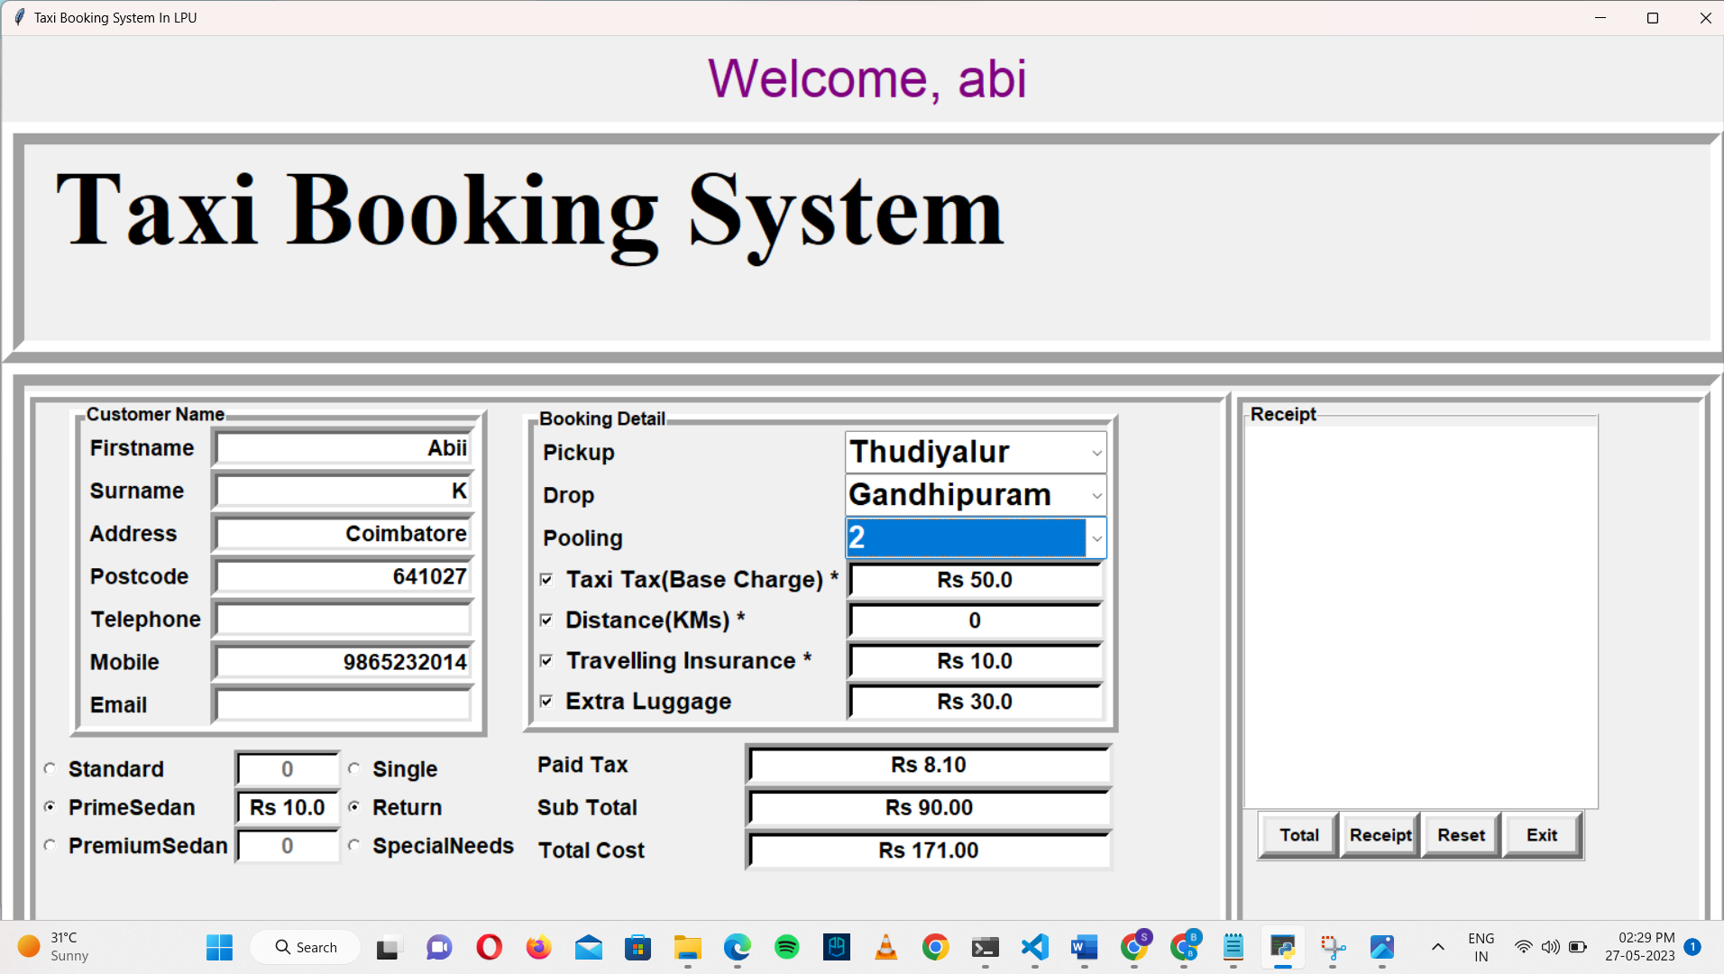
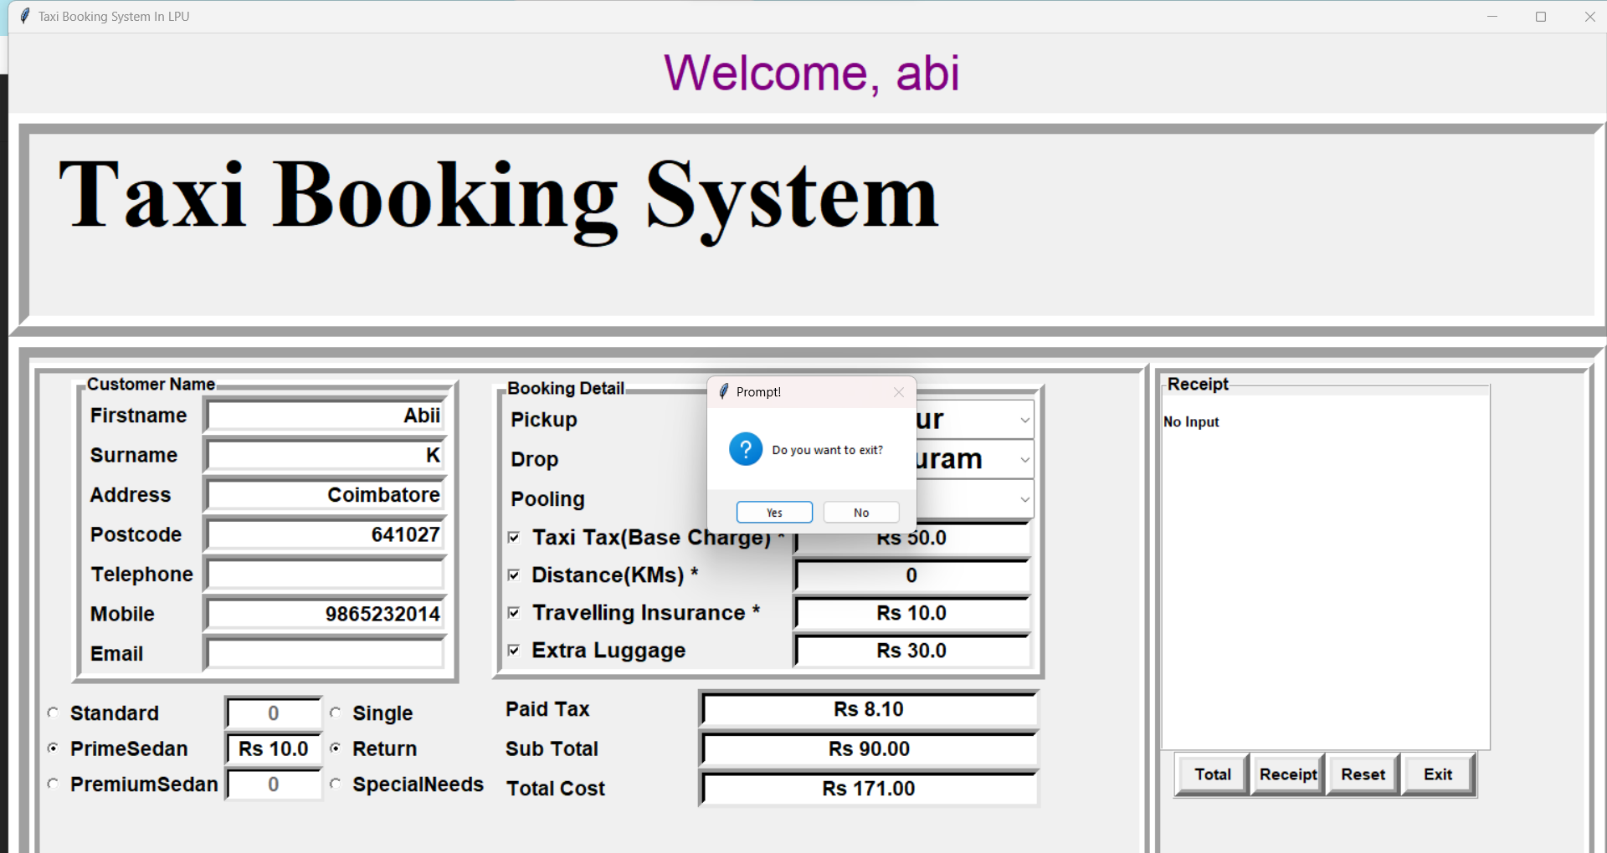

Slide 23
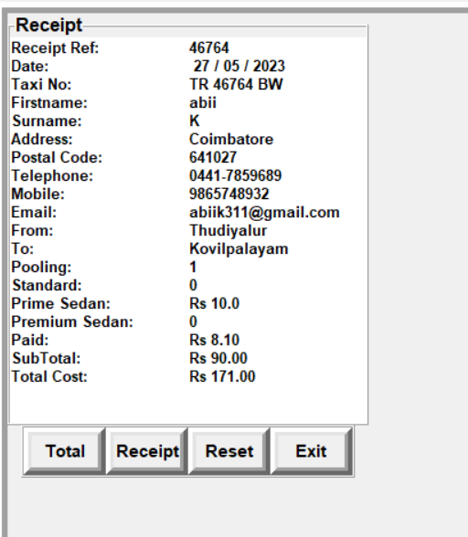
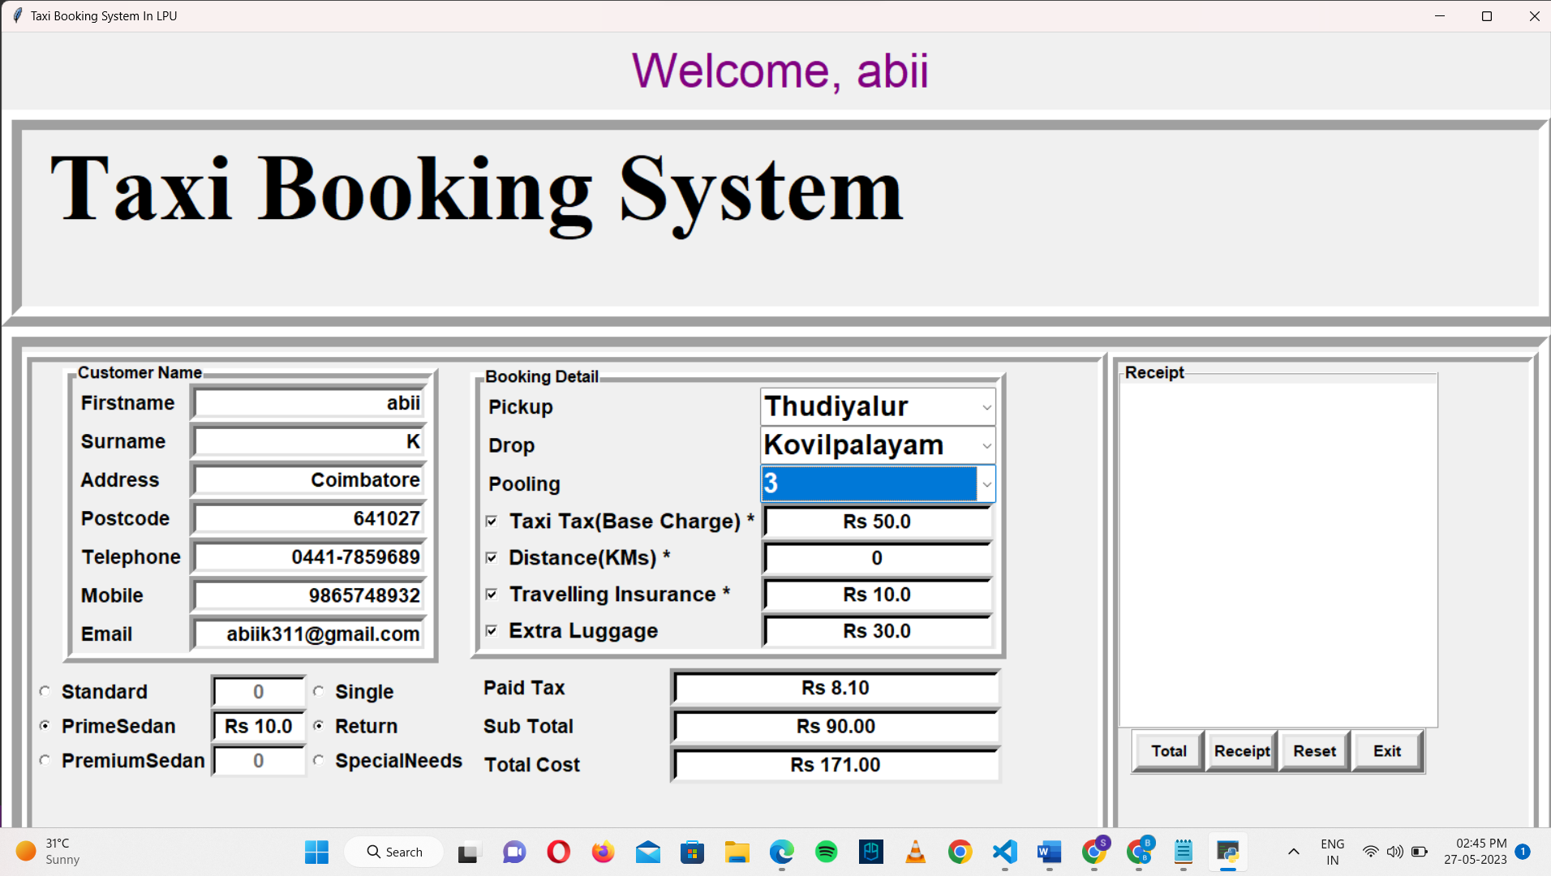

Slide 24
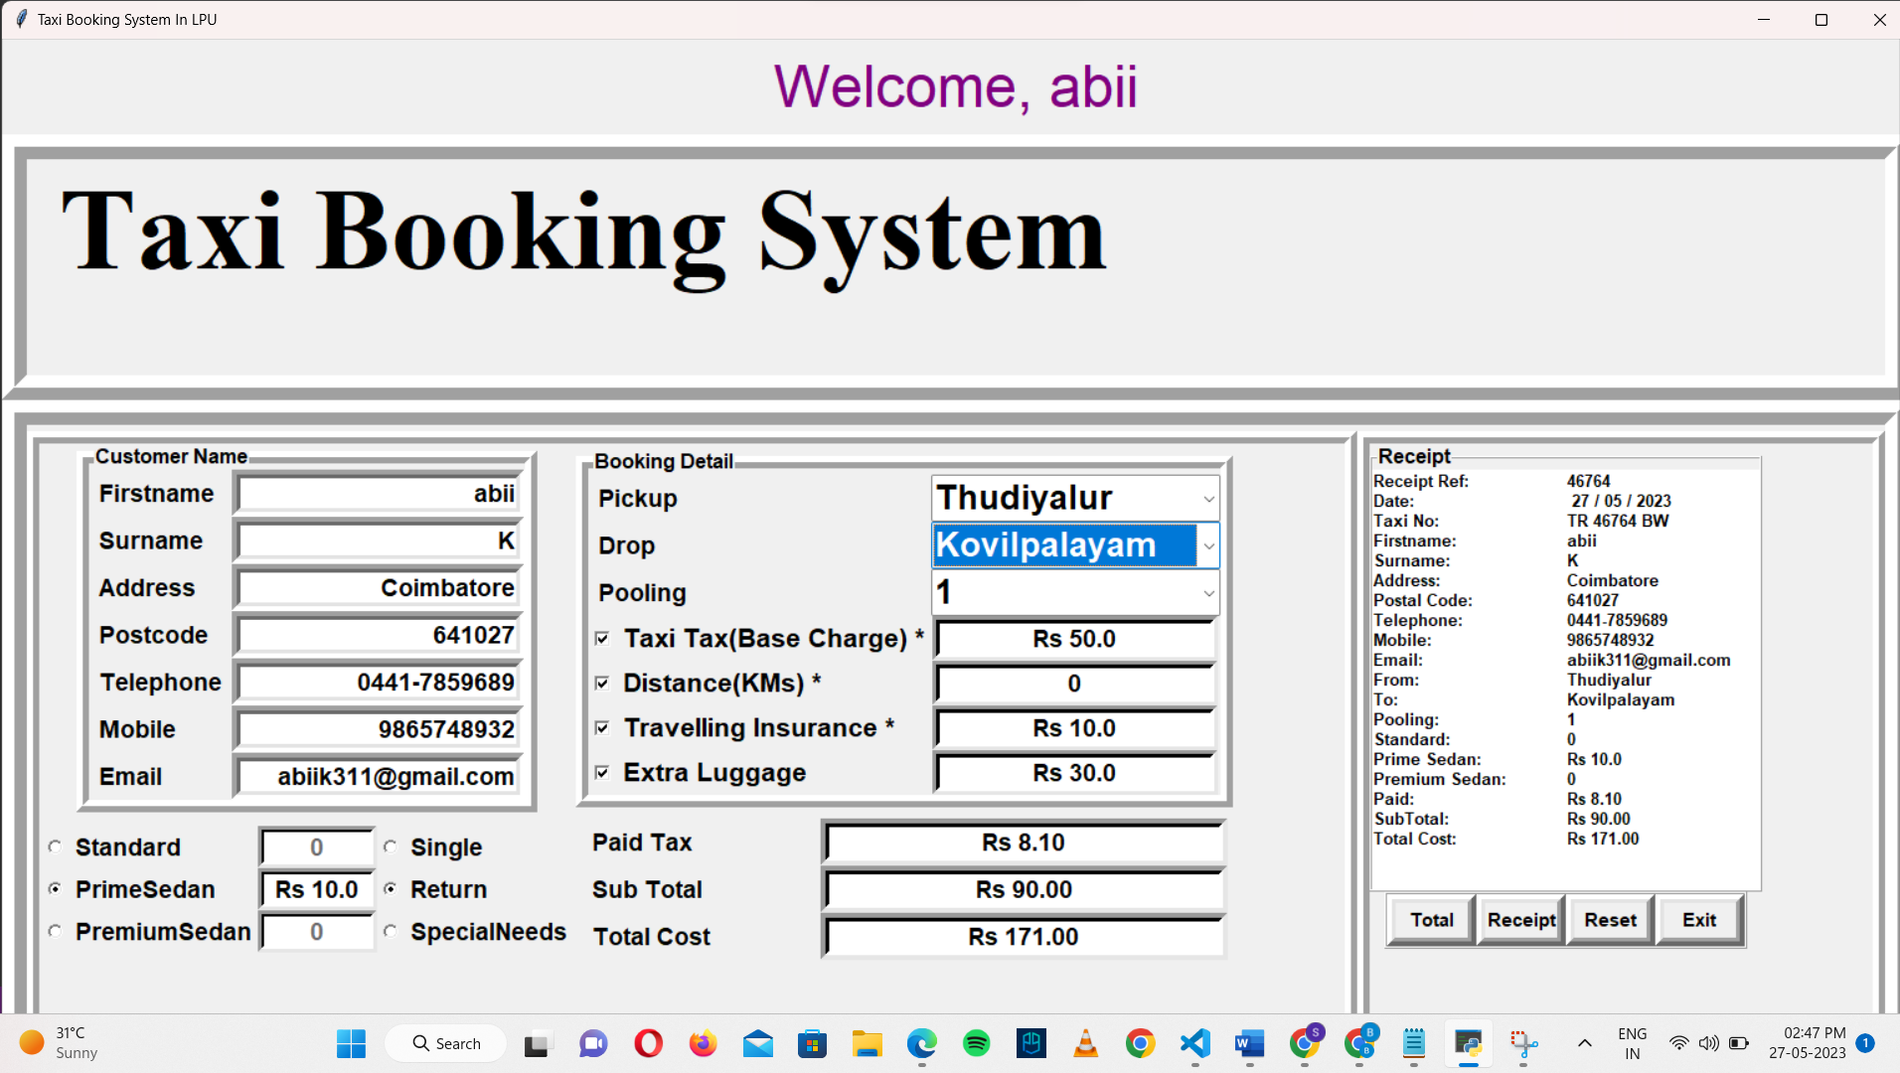

Slide 25
EXPECTED OUTCOME
The expected outcome of this plotted project work is to provide:
Easy access for all users .
Secured access for passengers .
Affordable facilities.
24x7 service.

Slide 26
REFERENCE
[1]“Design and Implementation of Taxi Management System” by Yueming Peng,Shanshan Liu, Xinglong Dai , an intelligent taxi dispatch system that uses real-time data to predict demand and optimize taxi routes.
[2] “Research on the optimization of allocating resources of urban taxi based on decision analysis model” by Weiyu Chen, Haochi Wu, Zhen Wang, Jialven Huang, ring Jiang, Jing Zhang, Lingxuan Zhu, depecting adecision analysis on taxi management.
[3] “A Service Choice Model for Optimizing Taxi Service Delivery”
by Shih-Fen Cheng and Xin Qu , covering different aspects of CUBA Platform, such as its architecture, data modeling, user interface design, business logic implementation, and deployment.

Slide 27
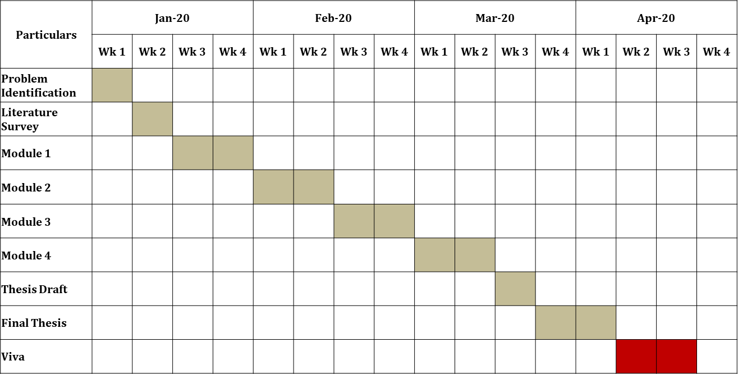
TIMELINE
Jan-2023
Feb-2023
Mar-2023
Apr-2023

Slide 28
THANK YOU

